Slide 1
HR Analytics Project
Team Members
Ravi Prakash Maurya
Pallamala Karthik
Katam Sai Ram
Proddutoor Thousif
Gutha Prasanna Kishore
Vovia Jagadeesan
Ediga Gopala Krishna

Slide 2
Index
Index
Introduction
Key Performance Indicators (KPIs) and Observations
Dashboards
Challenges Faced
Conclusion

Slide 3
Introduction
HR Analytics uses data-driven methods to understand and improve workforce performance.
It helps organizations make informed decisions about hiring, retention, and employee satisfaction.
The project focuses on analyzing factors such as attrition rate, job satisfaction, income, and work-life balance.
Tools like Excel, Tableau, Power BI, and SQL are used for data analysis and visualization.
The aim is to identify patterns and insights that can reduce employee turnover and enhance productivity.
By applying HR Analytics, companies can create a strategic, efficient, and employee-friendly work environment.

Slide 4
KPIS And Observations
Attrition Rate by Department
The Research & Development department shows the highest attrition rate at 51.21%, indicating potential job dissatisfaction or high stress levels.
Software and Support departments also have slightly high attrition rates (around 50–51%).
Hardware has the lowest attrition (49.44%), suggesting relatively better employee retention.
Overall, attrition rates are quite close across departments, averaging around 50%.

Slide 5
Hourly Rate of Male Research Scientists
The average hourly rate for male research scientists is $114.45.
This rate suggests a highly skilled position with competitive compensation.
However, no comparison with female employees or other roles is provided, which limits insight into pay equity.

Slide 6
Attrition Rate by Monthly Income
Employees earning ₹10,000–₹30,000 have slightly lower attrition rates (around 49.8–50%).
Attrition increases with higher income levels, reaching 51.26% for the ₹50,000–₹60,000 group.
This trend might indicate that higher-paid employees leave for better opportunities or due to job dissatisfaction unrelated to salary.
The relationship between income and attrition is not strongly negative, showing mixed factors influencing attrition.

Slide 7
Average of Working Year by Department
The Software department has the highest average working years (20.65), showing strong employee retention.
Sales (20.62) and Support (20.48) also show above-average tenure.
The Research & Development department has the lowest average working years (20.30), aligning with its high attrition rate.
This indicates that R&D employees tend to leave earlier, possibly due to workload or growth limitations.

Slide 8
Attrition Rate by Education Field
Medical field employees have the highest attrition rate (50.81%), indicating high job stress or demanding work conditions.
Life Sciences shows the lowest attrition (49.41%), suggesting better job satisfaction or stability.
Other fields such as Human Resources (50.28%), Marketing (50.07%), and Technical Degree (50.06%) remain around the average attrition mark (≈50%).
Overall, attrition rates are quite consistent across education fields, with only slight variations.

Slide 9
Work-Life Balance by Job Role
Manufacturing Director, Research Director, and Sales Executive roles show higher work-life balance ratings, indicating better satisfaction with work conditions.
Developers and Human Resources employees have lower work-life balance ratings, possibly due to workload or role demands.
Variation across roles suggests that managerial and senior-level roles often have better balance compared to technical or support roles.

Slide 10
Attrition Rate by Job Satisfaction
For females, attrition is highest (50.75%) at low satisfaction levels (rating 1) and decreases with higher satisfaction (49.74% at rating 4).
For males, a similar trend appears — lowest attrition (49.33%) at rating 1 but a slight increase (50.57%) at rating 4, showing less consistency.
In general, job satisfaction impacts attrition, with dissatisfied employees more likely to leave.
Females show a stronger correlation between satisfaction and attrition compared to males.

Slide 11
Attrition Rate by Gender
In the 18–25 and 26–35 age groups, males show slightly higher attrition rates (around 51%), suggesting early-career instability.
For 36–45, both genders show lower attrition (~49%), indicating more career stability with age.
In the 46–60 group, both male and female attrition rates rise slightly, possibly due to retirement or burnout factors.
Overall, gender differences are minor, but younger employees are more prone to attrition.

Slide 12
Attrition Rate by Job Satisfaction
For female employees, attrition is highest (50.75%) at the lowest satisfaction level (Rating 1) and decreases gradually to 49.74% at the highest satisfaction level (Rating 4).
For male employees, attrition is lowest (49.33%) at Rating 1, then increases slightly to 50.57% at Rating 4, showing a less consistent pattern.
Overall, females show a stronger negative correlation between job satisfaction and attrition higher satisfaction leads to lower attrition.
In contrast, male attrition remains relatively stable regardless of satisfaction level, suggesting that other factors may influence their decision to stay or leave.
The analysis indicates that improving job satisfaction, especially among female employees, can help reduce attrition rates.

Slide 13
Dashboard’s

Slide 14
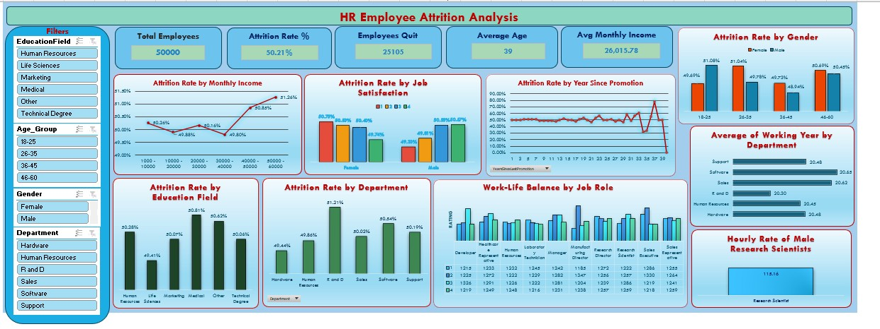
Excel Dashboard

Slide 15
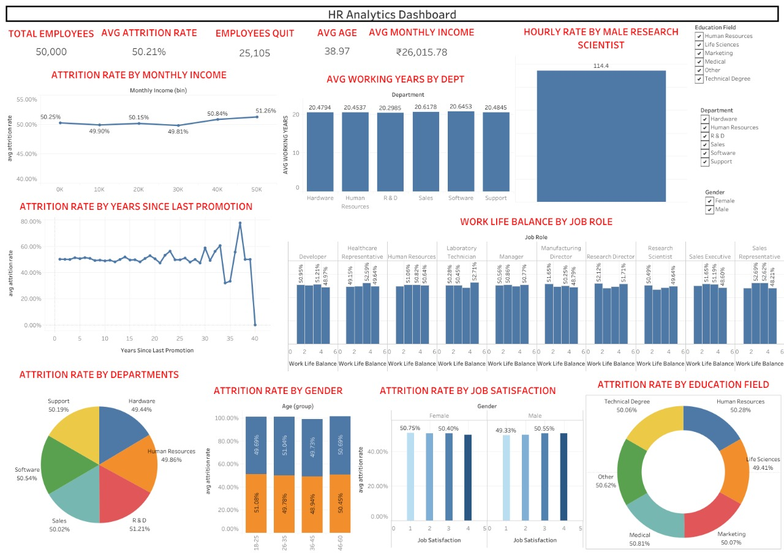
Tableau Dashboard

Slide 16
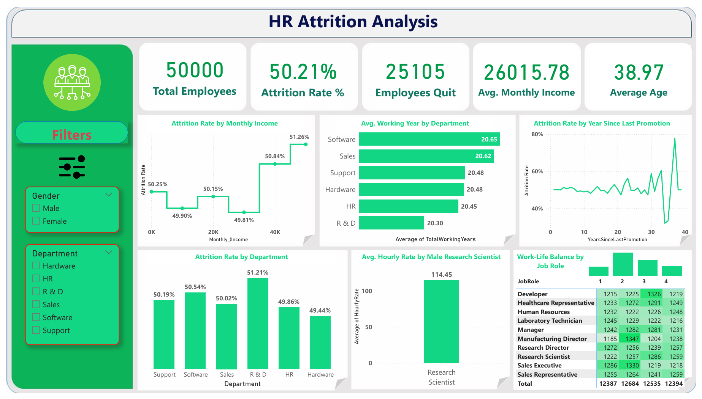
Power BI Dashboard

Slide 17
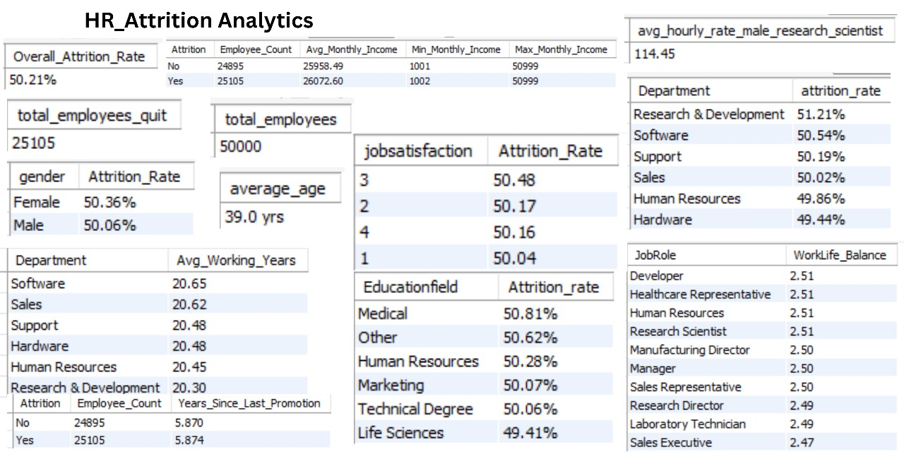
SQL Queries

Slide 18
Challenges Faced
Data Cleaning & Preprocessing – Handling null values, duplicate entries, and formatting data for analysis took significant time.
Identifying Key Metrics – Selecting the most relevant KPIs (like attrition rate, job satisfaction, income) among many available fields was challenging.
Interpreting Results – Some correlations (e.g., between income and attrition) were not straightforward, requiring deeper analysis.
Team Coordination – Synchronising work among multiple members while maintaining consistency in findings and visuals.

Slide 19
Conclusion
The overall employee attrition rate is around 50%, showing moderate turnover across all departments.
The Research & Development department records the highest attrition, indicating potential job dissatisfaction or workload pressure.
Job satisfaction and work-life balance are major factors influencing employee retention.
Employees with higher satisfaction ratings tend to stay longer in the organization.
Income levels show mixed impact on attrition — higher salaries don’t always guarantee retention.
Younger employees (18–35 years) have higher attrition rates compared to older age groups.
Departments with longer average working years show better engagement and stability.
Improving career growth opportunities, satisfaction, and balance can significantly reduce attrition.
Overall, HR Analytics helps in making data-driven decisions to improve employee retention and organizational performance.

Slide 20
Thank You

